Slide 1
IDLER MONITORING DEVICE FOR CONVEYOUR BELTS
ALEX THIRUVARATHAN M J
HARI VENGATESH M
YUVARAJ KUMAR M
EEE – 2ND YEAR
VELAMMAL ENGINEERING COLLEGE - CHENNAI

Slide 2
INTRODUCTION
A belt conveyor is a widely used mechanical system for transporting materials efficiently in various industries. However, like any machinery, belt conveyors can sometimes encounter issues such as dislodgment, which occurs when the conveyor belt slips out of place or becomes misaligned.
Dislodgment of a belt conveyor can lead to disruptions in production, safety hazards, and potential damage to the equipment. Understanding the causes and consequences of belt dislodgment is crucial for ensuring smooth operation and minimizing downtime.

Slide 3
CONTENT
  ABSTRACT
  EXISTING AND PROPOSED SOLUTION
  REQUIREMENT
  BLOCK DIAGRAM
  BENEFITS
  APPLICATION
  CONCLUSION

Slide 4
ABSTRACT
Belt conveyors play a pivotal role in the transportation of bulk materials across various terrains, including hilly landscapes. The conveyor passing suffers belt dislodgements due to various reasons.The consequences of these disruptions include costly downtime, material spillage, and safety hazards.
This paper proposes an intelligent monitoring system, The system integrates sensors,and real-time monitoring to detect and prevent potential dislodgement events before they occur.

Slide 5
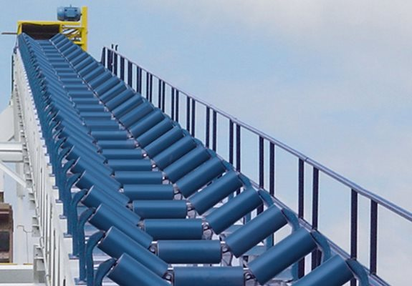
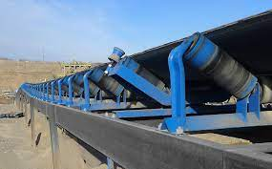

Slide 6
OBJECTIVE
The device should serve following features
To Maintain proper troughing angle
To Monitor the belt tracking and keep it always in a central position
Implementing a Notification Mechanism

Slide 7
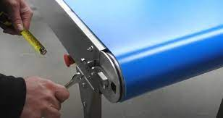
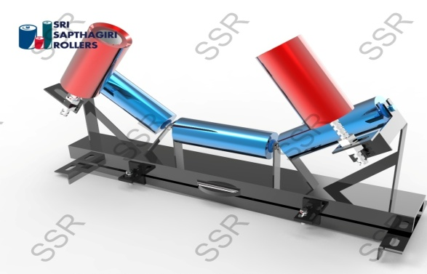
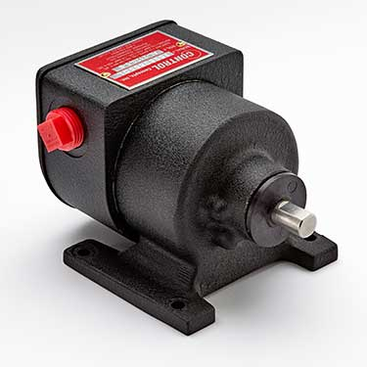
EXISTING SOLUTION
Conventional approaches to misalignment monitoring in conveyor systems often hinge on manual inspections
Self-aligning idlers are engineered to automatically correct and maintain the alignment of both sides of conveyor belts internally
Regulating the motor to oversee the prevention of conveyor belt misalignment.

Slide 8
PROPOSED SOLUTION
Designing a Belt Tracking Monitoring Device by Integrating a Light Sensor Adjacent to the Motor, Employing a Buzzer as an Alarm to Detect Heightened Misalignment, and Incorporating a Bluetooth Module for Instant Alert Notifications.

Slide 9
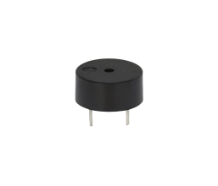
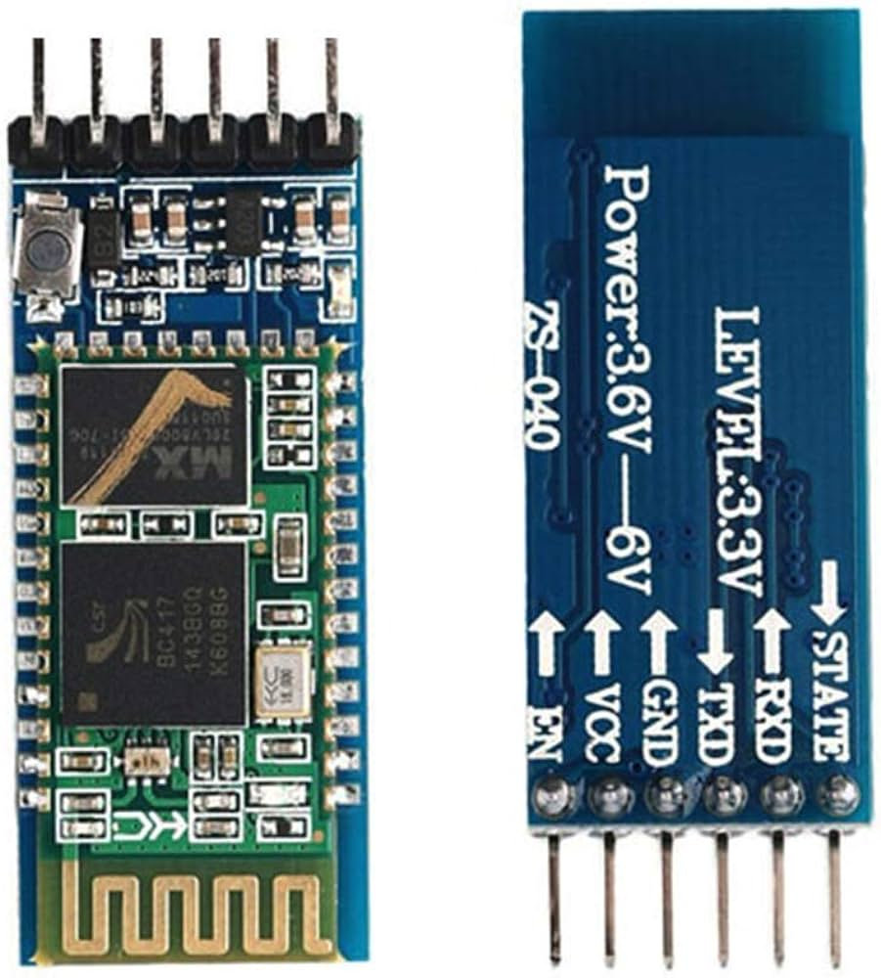
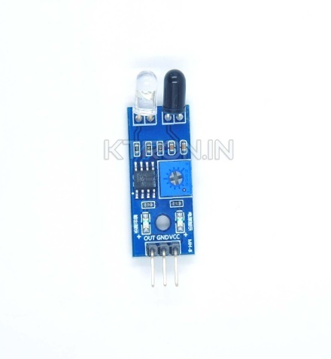
COMPONENTS REQUIRED
  Arduino UNO board
  Infrared Sensor
  Bluetooth module
  Buzzer
  Connecting Wires

Slide 10
BLOCK DIAGRAM
BUZZER
POWER
SUPPLY
ARDUINO UNO
IR SENSOR
BLUETOOTH MODULE
RECEIVE SMS

Slide 11
ADVANTAGES
Improved Efficiency: Proper belt tracking ensures that the conveyor belt stays centered on the rollers, minimizing friction and wear.
Enhanced Safety: Belt misalignment can lead to accidents such as material spillage, belt slippage, or even belt derailment.
Real-time Monitoring and Alerts: This allows operators to take immediate corrective actions, preventing potential issues from escalating.

Slide 12
CONCLUSION
In this paper, we present a conveyor belt monitoring system designed to enhance operational efficiency and reduce maintenance costs. Our system integrates infrared (IR) sensors to detect misalignment along the conveyor belt. When misalignment is detected, alerts are transmitted via a Bluetooth module to smartphones, while a buzzer notifies nearby workers. By leveraging this technology, operators can swiftly identify issues, allowing for timely corrective actions. Consequently, this system minimizes repair expenses and reduces spillage costs, thereby streamlining operations and improving overall productivity.

Slide 13
REFERENCES
Design and development of self-aligning troughing idler used in belt conveyor system
Condition monitoring of Self aligning carrying idler (SAI) in belt-conveyor system using statistical features

Slide 14
THANK YOU

